Slide 1
A Convolutional Encoder Model
for Neural Machine Translation
Jonas Gehring, Michael Auli, David Grangier, Yann N. Dauphin Facebook AI Research
2020-02-20
JuHyoung Kim
kjhkjh75@naver.com

Slide 2
-INTRODUCTION
NMT is an end-to-end approach to machine translation
The most successful approach to date encodes the source sentence with
A bi-directional RNN
1) variable length representation
2) generates the translation left-to-right with another RNN
where both components interface via a soft-attention mechanism.
There are some attempts to use convolutional encoder
but only applied to rescoring n-best lists of classical systems
or were not competitive to recurrent alternatives
Convolutional networks operate over a fixed-size window of the input sequence which enables the simultaneous computation of all features for a source sentence.

Slide 3
-INTRODUCTION
A succession of convolutional layers provides a shorter path to capture relationships between elements of a sequence compared to RNNs
-> Eases learning because the resulting tree-structure applies a fixed number of non-linearities compared to a recurrent neural network.
In CNN, all words undergo the same number of transformations,
Whereas, RNNs the first word is over-processed and the last word is only once

Slide 4

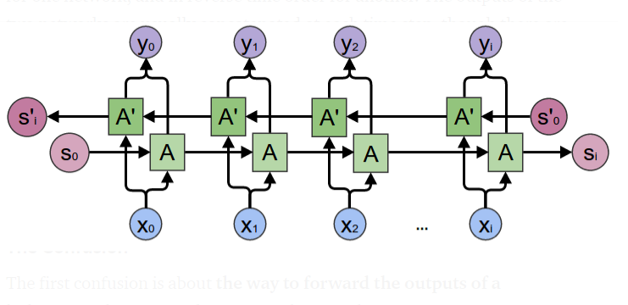
- Recurrent Neural Machine Translation.
General architecture follows the encoder-decoder approach with attention
Translation model computes a distribution over the V possible target words yi+1 by transforming the LSTM output hi via a linear layer with weights Wo and bias bo
The conditional input ci at time I is computed via a simple dot-product style attention mechanism.

Slide 5
- Non-recurrent Encoders.
Pooling Encoder
A simple baseline for non-recurrent encoders is the pooling model described in (Ranzato et al) averages the embeddings of k consecutive words.
Averaging word embeddings does not convey positional information besides that the words in the input are somewhat close to each other.
As a remedy, add position embeddings to encode the absolute position of each source word within a sentence.
Each source embedding ej therefore contains a position embedding lj as well as the word embedding wj,.
Position embeddings have also been found helpful in memory networks for question-answering and language modeling.

Slide 6
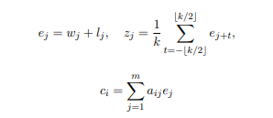
- Non-recurrent Encoders.
Similar to the recurrent encoder, the attention scores aij are computed from
pooled representations zj, however, the conditional input ci is a weighted
sum of the embeddings ej,not zj, i.e.,
Input sequence is padded prior to pooling such that the encoder output matches the input length |z| = |x|.

Slide 7
- Convolutional Encoder
The encoder output zj contains information about a fixed-sized context depending on the kernel width k but the desired context width may vary.
This can be addressed by stacking several layers of convolutions followed by non linearities : additional layers increase the total context size while non-linearities can modulate the effective size of the context as needed.
To ease learning for deep encoders, add residual connections from the input of each convolution to the output and then apply the non-linear activation function to the output

Slide 8

- Convolutional Encoder
The CNNs do not contain pooling layers which are commonly used for down-sampling.
The full source sequence length will be retained after the network has been applied.
Similar to the pooling model, the convolutional encoder uses position embeddings.
The final encoder consists of two stacked convolutional networks
CNN-a produces the encoder output zj to compute the attention
scores ai, while the conditional input ci, to the decoder is computed
by summing the outputs of CNN-c,

Slide 9
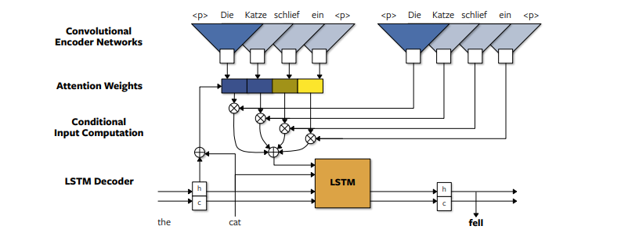
- Convolutional Encoder
Neural machine translation model with single-layer convolutional encoder networks. CNN-a is on the left and CNN-c is at the right. Embedding layers are not shown.

Slide 10
- Related work
Several past attempts to use convolutional encoders for neural machine translation, however, none of them were able to match the performance of Recurrent encoders.
(Kalchbrenner et al., 2016)
Introduced convolutional translation models without an explicit attention mechanism but their approach does not yet result in state-of-the-art accuracy
(Lamb and Xie, 2016)
Proposed a multi-layer CNN to generate a fixed-size encoder representation but their work lacks quantitative evaluation in terms of BLEU
(Meng et al. 2015) and (Tu et al., 2015)
Applied convolutional models to score phrase-pairs of traditional phrase-based and dependency-based translation models
(pham et al., 2016)
Convolutional architectures have also been successful in language modeling but so far failed to outperform LSTMs

Slide 11
- Experiment Setup
1. Datasets
1) WMT`16 English-Romanian
2) WMT`15 English-German
3) WMT`14 English-French
Model parameters
3. Optimization
- Recurrent models are trained with Adam
benefit from aggressive optimization.
-SGD,annealing.

Slide 12
- Experiment Setup
4. Evaluation
- report accuracy of single systems by training several identical models
with different random seeds(5 for IWSLT`14, 3 for WMT) and pick the
one with the best validation perplexity for final BLEU evaluation.
- Translation are generated by a beam search and we normalize
log-likelihood scores by sentence length.
- prior to scoring the generated translations against the respective
references, perform unknown word replacement based on attention
scores.
- If the dictionary contains no translation, then we simply copy the
source word.

Slide 13
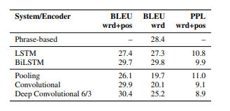
- Result
Recurrent vs Non-recurrent Encoders
- compare in terms of perplexity and BLEU on IWSLT`14
with and without position embeddings.
and include a phrase-based system.
6/3 means
6 layers for CNN-a
3 layers for CNN-c

Slide 14
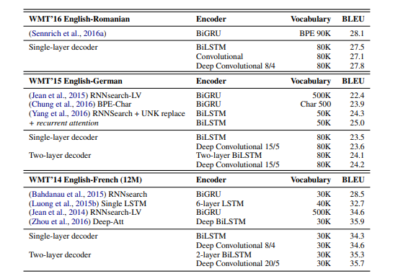
- Result

Slide 15
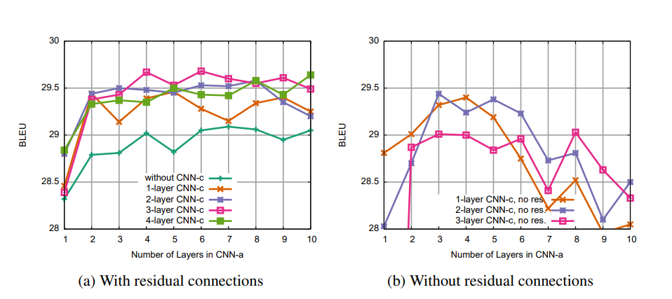
- Result
3. Convolutional Encoder Architecture Details
Use the smaller IWSLT`14 German-English setup without unknown word
replacement to enable fast experiment turn-around
- Shows accuracy for a different number of layers of both CNNs with and without residual connections.

Slide 16
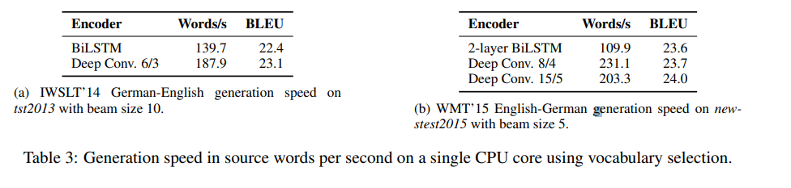
- Result
4. Training and Generation Speed

Slide 17
Conclusion
Introduced a simple encoder model for neural machine translation based on convolutional networks.
More parallelizable than recurrent networks and provides a shorter path to capture long-range dependencies in the source.
We find it essential to use source position embeddings as well as different CNNs for attention score computation and conditional input aggregation.
Experiments show the convolutional encoders perform on par or better than baselines based on bi-directional LSTM encoders.
Deep convolutional encoder is competitive to the best published results to date which are obtained with significantly more complex models or stem from improvements that are orthogonal to our work.

Slide 18
Conclusion
Leads to large generation speed improvements :
translation models with our convolutional encoder can translate twice as fast as strong baseline with bi-directional recurrent encoders
Future work includes better training to enable faster convergence with the convolutional encoder to better leverage the higher processing speed.
Architecture is interesting for character level encoders where the input is significantly longer than for words.
Plan to investigate the effectiveness of architecture on other sequence to sequence tasks

Slide 19
- Future work
Check sequence to sequence model with cnn paper
Check the categorizing bug with similarities or classification method.

